Slide 1


K.RAMAKRISHNAN COLLEGE OF TECHNOLOGY (AUTONOMOUS), TRICHY
Shiny-Based App for Analyzing
Monthly Pocket
Money Usage
PRESENTED BY
VIMALSHREE M -2303811724322122

Slide 2
PRESENTATION OVERVIEW
Problem Identification
Objective
Proposed system
Block diagram of proposed system
R libraries used
Advantages of proposed system
Modules description
Module implementation

Slide 3
PROBLEM IDENTIFICATION
1. Lack of Awareness on Spending Patterns
Many individuals, particularly younger users, don’t have a clear understanding of where their money goes each month. Without tracking tools, they may unknowingly overspend or not realize how small expenses add up over time.
2. Difficulty in Tracking and Categorizing Expenses
Manually tracking spending is tedious and often inconsistent. Users struggle with categorizing different types of spending, making it hard to see the bigger picture. A simple, automated tool would make this process more efficient and less time-consuming.
3. Challenges in Maintaining Consistency
Users may start tracking their spending with good intentions but may find it difficult to stay consistent over time. An engaging and easy-to-use platform, such as a Shiny app, could provide reminders, progress tracking, and motivate users to keep up with their financial tracking
2/7/20

Slide 4
OBJECTIVE
1. Develop a User-Friendly Interface for Expense Tracking
Create a simple and intuitive platform where users can easily input and track their monthly pocket money usage across various categories (e.g., food, entertainment, savings, etc.).
2. Automate Expense Categorization
Implement features that allow users to automatically categorize their expenses (e.g., using predefined categories or allowing custom tags) to provide an organized overview of spending habits.
3. Enable Budget Setting and Goal Tracking
Allow users to set personal spending limits or saving goals for each category and track their progress, helping them stick to a budget and improve financial discipline.

Slide 5
R LIBRARIES USED
1.User Interface (Shiny App):
shiny – Builds interactive web applications.
shinydashboard – Creates structured dashboard layouts.
2.Data Processing & Visualization:
ggplot2 – Generates graphs and visualizations.
dplyr – For data manipulation and filtering.
tidyverse – A collection of data science packages including ggplot2, dplyr, and readr.
DT – Displays interactive tables.
3.Machine Learning Models:
rpart – Decision Trees for expense categorization.
randomForest – Random Forest for classification of expenses.
isotree – Isolation Forest for anomaly detection.
kmeans – Built-in stats package function for clustering users based on spending patterns

Slide 6
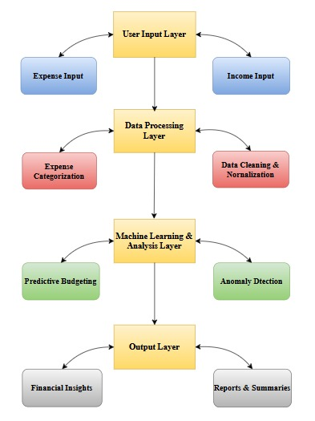
PROPOSED SYSTEM
BLOCK DIAGRAM

Slide 7
ADVANTAGES OF PROPOSED SYSTEM
1. User-Friendly Interface
The Shiny framework allows for the development of a highly interactive and intuitive app that is easy for users to navigate, even for those with little to no experience in financial tracking or budgeting.
2. Automated Expense Categorization
The app uses machine learning models like decision trees or random forests to automatically categorize expenses into predefined categories (e.g., food, entertainment, savings), reducing the time and effort needed to manually track each transaction.
3. Real-Time Spending Insights
The app provides real-time insights into users' spending patterns through dynamic visualizations (like graphs and pie charts). It tracks spending as it happens, offering users immediate feedback.

Slide 8
MODULES USED
User Authentication Module.
Dashboard & User Interface Module.
Expense Entry & Data Storage Module.
Expense Categorization Module.

Slide 9
MODULES DESCRIPTION
1.User Authentication Module:
Handles user registration and login functionality, ensuring data security and personalized experience for each user.
2.Dashboard & User Interface Module:
Uses shiny and shinydashboard to provide a clean, interactive layout where users can input expenses, view charts, and navigate easily.

Slide 10
MODULES DESCRIPTION
3.Expense Entry & Data Storage Module:
Allows users to enter daily/monthly expenses. Data is stored in a structured format for further processing.
4. Expense Categorization Module:
Automatically categorizes expenses using ML models like rpart, randomForest, and custom tags provided by users.

Slide 11
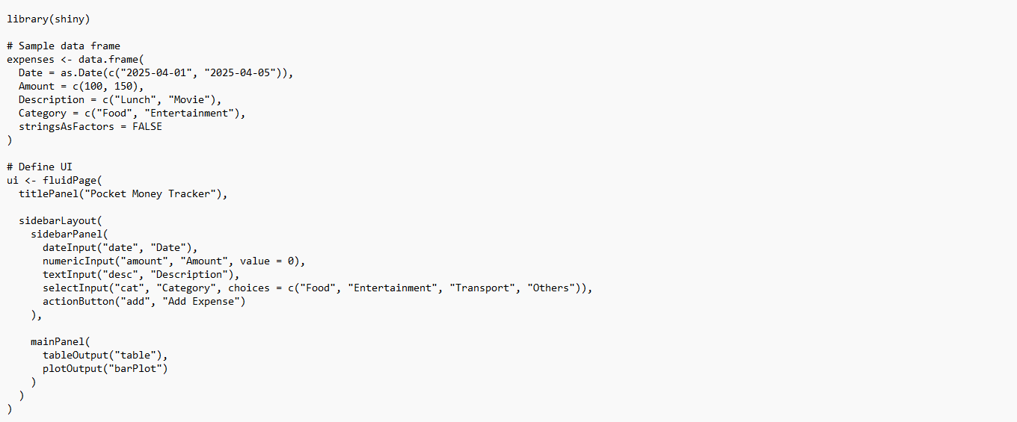
CODING IMPLEMENTATION

Slide 12
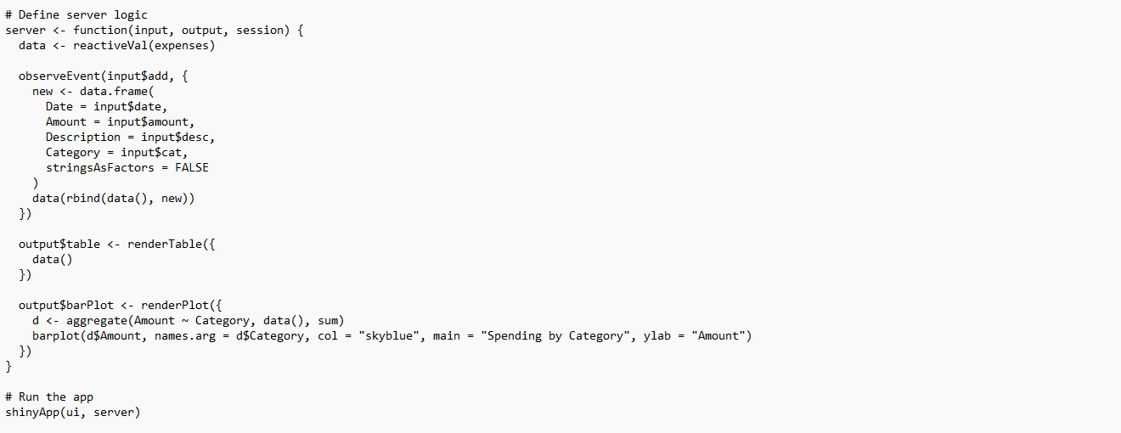
CODING IMPLEMENTATION

Slide 13
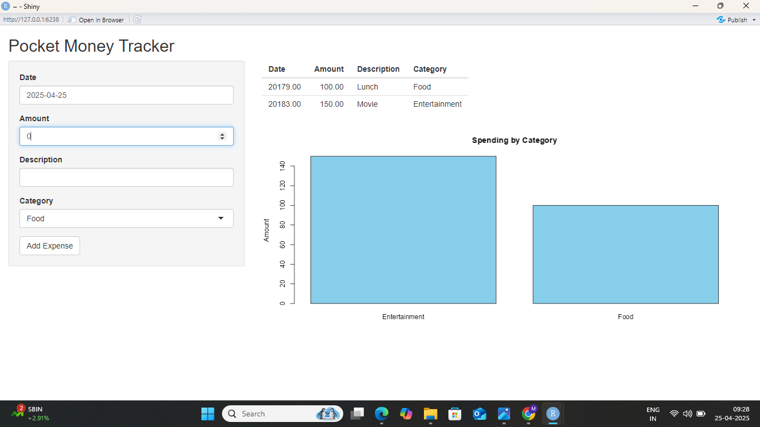
OUTPUT

Slide 14


